Slide 1
Statistical Methods for Decision Making
Probability and Bayes’ Theorem

Slide 2
Agenda
Probability Overview
Types of Probability
Rules for computing probability
Marginal probability
Conditional probability
Bayes Theorem and its Applications

Slide 3
Statistical Learning ( TOC )
Sno | Topic | Scope
1 | Probability Overview | What is probability, its range, application, how to calculate, types of event, experiment
2 | Types of Probability | Types of probability
3 | Rules for computing probability | Ways to compute probability, joint, marginal, conditional probability
4 | Bayes Theorem and its Applications | Bayes theorem, conditional probability, application of bayes theorem

Slide 4
Probability Overview
Probability refers to chance or likelihood of a particular event-taking place.
An event is an outcome of an experiment.
An experiment is a process that is performed to understand and observe possible outcomes.
Set of all possible outcomes of an experiment is called the sample space.
Example: Experiment - tossing a coin
Event - occurrence of head when a fair coin is tossed
Sample space - head, tail
Probability - likelihood of getting head when a fair coin is tossed ( 0.5)

Slide 5
Probability Overview
Probability value ranges from [0,1]
When will the P(A) will be zero ?
Probability of getting 0 when you roll a dice.
When will the P(A) will be one?
Probability of getting an integer when you roll a dice

Slide 6
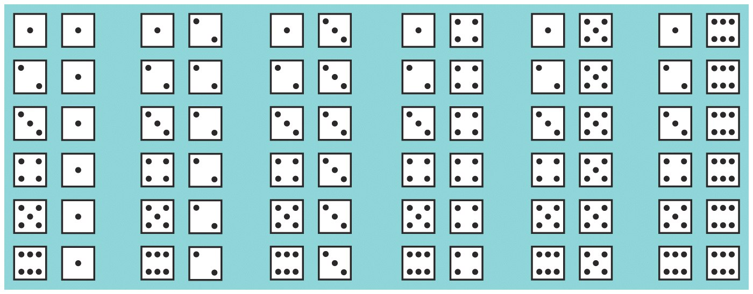
Example 1 : Rolling of Dice
Ex 1:Two unbiased dice are thrown. What is the probability of getting sum of their outcome as 7?

Slide 7
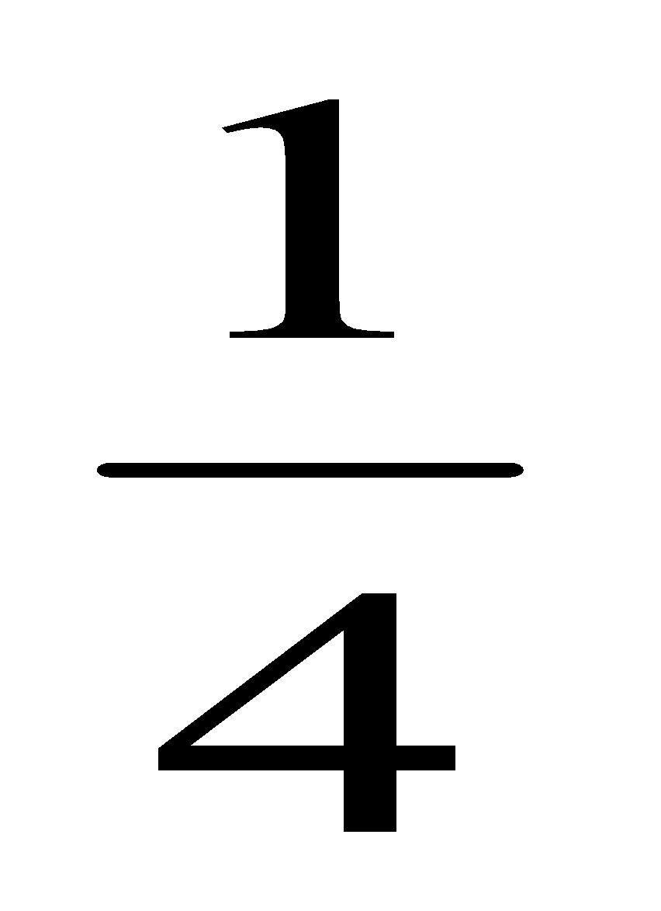
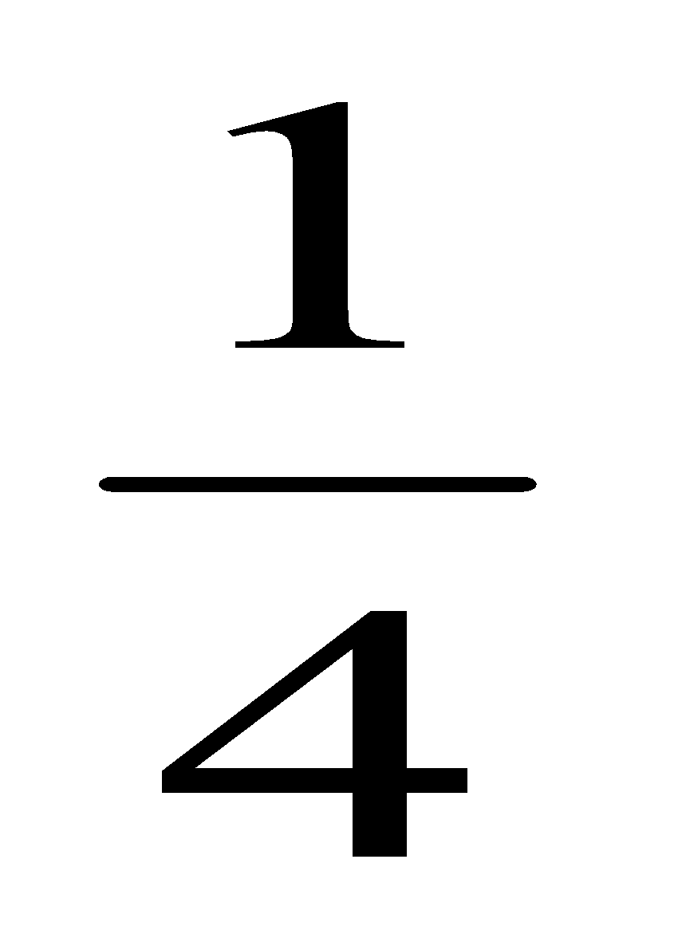
Example 2 : Tossing a coin
A fair coin is tossed twice. What is the probability of getting at least one head?
Outcome
of coin
Exhaustive
Outcomes
Probability
Coins
T
TT
P(at least 1 head)
= P(TH) + P(HT)+
P(HH)
= 3/4
C
H
TH
T
HT
C
HH
H

Slide 8
Probability Overview - Applications
To quantify uncertainty of an outcome
Inferential statistics is built on the foundation of probability theory.
Helps in deriving conclusions from data
To estimate occurence an event
Used in Machine Learning algorithms to estimate or predict an outcome

Slide 9
Probability Overview
Probability of a single event is defined as :
P = Number of favorable outcomes
Number of possible equally likely outcomes
Example - If you roll a dice, there are 6 possible outcomes, and each of these are equally likely.
Possible outcomes (sample space) = 1,2,3,4,5,6
Event (E) - probability of getting an even number. Favorable outcomes = 2,4,6
Probability = P(E) = 3/6 = 0.5

Slide 10
Probability Overview
Probability of two or more events :
Case 1: probability of events A or B
Case 2: probability of events A and B
Joint probability - probability of two events occurring simultaneously
Case 3 : probability of event X=A given variable Y
Marginal probability - probability of an event irrespective of the outcome of another variable
Case 4 : A given B
Conditional probability - probability of one event given the occurrence of another event
Notes:
Explained in details below

Slide 11
Probability Overview
Mutually Exclusive Events | Independent Events
Two events A and B are said to be mutually exclusive if they cannot occur at the same time. Or occurence of A excludes occurence of B. Example - when you toss a coin, getting a head or a tail are mutually exclusive as either head or tail will appear in case of an ideal scenario. A = Head when a fair coin is tossed B = Tail when a fair coin is tossed A = The roll of a die is odd B = The roll of a die is even | Two events A and B are said to be independent if the occurrence of A is in no way influenced by the occurrence of B. Likewise occurrence of B is in no way influenced by the occurrence of A. Example - when you toss a fair coin and get head and then you toss it again and get a head A = Getting head in first toss of a fair coin B = getting head again in the second toss of a fair coin

Slide 12
Types of Probability
A Priori Classical Probability
When a fair coin is tossed. What is the probability of getting a tail?
Empirical Probability :
What is the probability that a man lives for 1000 years?
Subjective Probability
Chance of India winning the next world cup?
Notes:
A priori classical probability - derived from deductive reasoning.
Empirical Probability - estimate of a probability based on an observation
Subjective Probability - derived from an individual's personal judgment or own experience about whether a specific outcome is likely to occur. It contains no formal calculations and only reflects the subject's opinions and past experience

Slide 13
Rules for computing probability
Addition Rule - Mutually exclusive events
P(AUB) = P(A) + P(B)
Probability of union of A and B is determined by adding probability of the events of A and B
Example - From a pack of well-shuffled cards, a card is picked up at random.
What is the probability that the selected card is a King or a Queen?
Event A = Probability of getting a King
P(A) = 4/52
Event B = Probability of getting a Queen
P(B) = 4/52
P(AUB) = 2/13
A
B

Slide 14
Rules for computing probability
Addition Rule - Events are not Mutually exclusive events
P(AUB) = P(A) + P(B) - P(A∩B)
Probability of union of A and B is determined by adding probability of the events of A and B and then subtracting probability of the intersection of the events A and B
Example - From a pack of well-shuffled cards, a card is picked up at random.
What is the probability that the selected card is a King or a Diamond?
Probability of getting a King, P(A) = 4/52
Probability of getting a Diamond, P(B) = 13/52
Probability of getting a diamond king,
P(A∩B) = 1/52
P(AUB) = 4/52 + 13/52 - 1/52 = 16/52 = 4/13
A
B

Slide 15
Rules for computing probability
Multiplication Rule - Independent events
P(A∩B)= P(A) * P(B)
When two events A and B are independent, the probability of simultaneous occurrence of A and B equals the product of probability of A and probability of event B.
Can be extended to more than two events
Example ( Assuming A and B are independent)
Event A = Probability of getting A grade in a maths exam is 0.7
Event B = Probability of getting A grade in a science exam is 0.6
Probability of getting A grade in both maths and science exam will be
= 0.7*0.6 = 0.42

Slide 16
Rules for computing probability
Multiplication Rule - When events are not independent
P(A∩B)= P(A) * P(B/A)
P(A∩B)= P(B) * P(A/B)
When two events A and B are not independent, the probability of simultaneous occurrence of A and B equals the product of probability of A and probability of event B given that A has happened.
Example - from a deck of cards, two cards are drawn in succession one after the other ( Without replacement). What is the probability that both the cards are hearts?
P( Hearts) = P(A) = 13/52
P( Second is also heart) = 12/51
P(A∩B) = 3/51 = 1/17

Slide 18
Marginal Probability
Case 3 : probability of event X=A given variable Y
Marginal probability - probability of an event irrespective of the outcome of another variable
The term marginal is used to indicate that the probabilities are calculated using a contingency table (also called joint probability table).
Contingency table consists of rows and columns of two attributes at different levels with frequencies or numbers in each of the cells. It is a matrix of frequencies assigned to rows and columns.
The marginal probability of one variable (X) would be the sum of probabilities for the other variable (Y rows) on the margin of the table.

Slide 19
Marginal Probability
Example - we have a data of few candidates who studied for some number of hours for an exam and and whether they pass or fail the exam
What is the probability that a randomly selected student passed the exam?
What is the probability that a randomly selected student who passed the exam studied for more than 5 hours?
Exam Status | No. hours studied <5 | No. hours studied >5 | Total
Pass | 38 | 42 | 80
Fail | 82 | 38 | 120
Total | 120 | 80 | 200

Slide 20
Marginal Probability
1) What is the probability that a randomly selected student passed the exam?
80/200 =0.40
2) What is the probability that a randomly selected student who passed the exam studied for more than 5 hours?
42/200 =0.21
3) A student selected at random is found to be studying for more than 5 hours What is the probability that he failed the exam?
38/80 =0.475
Note this is a case of conditional probability

Slide 21
Conditional Probability
Case 4 : A given B
Conditional probability : probability of one event given the occurrence of another event
The conditional probability for events A given event B is calculated as follows:
P(A given B) = P(A and B) / P(B)
P(A/B) = P(A∩B)/ P(B)
Example - Probability of getting a king given that it is a hearts
P(A) = 4/52
P(B) = 13/52
P(A∩B) = 1/52
P(A/B) = 1/13

Slide 22
Rules for computing probability
Event | Probability
A | P(A) ranges from [0,1]
Not A | 1-P(A)
A or B ( AUB) | P(AUB) = P(A) + P(B) - P(A∩B)
A or B ( AUB) for mutually exclusive events | P(AUB) = P(A) + P(B)
A and B P(A∩B) | P(A∩B)= P(A) * P(B/A)
A and B P(A∩B) when A and B are independent | P(A∩B)= P(A) * P(B)
A given B has occurred | P(A/B)= P(A∩B)/P(B) = P(A)* P(B/A) /P(B)
B given A has occurred | P(B/A) = P(A∩B)/P(A)

Slide 23
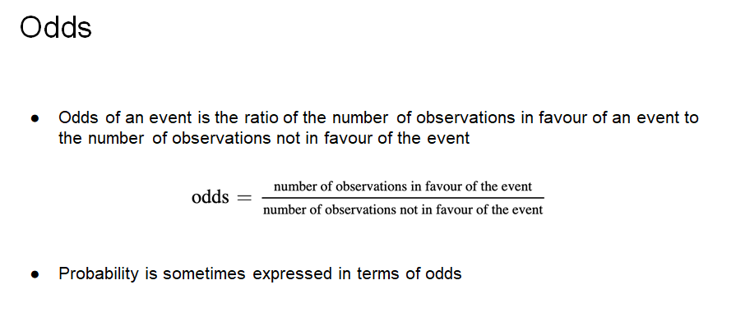

Slide 24
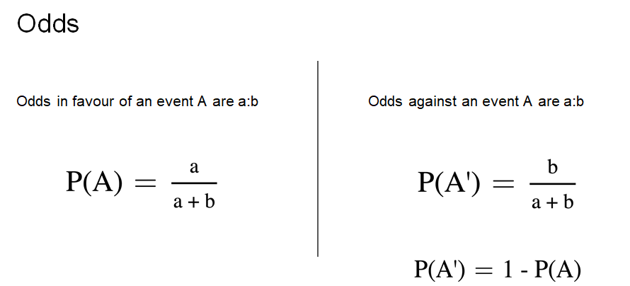

Slide 25
Odds - Question
Question:
The odds that a New Yorker picked at random will be either overweight or obese are 14:11. What is the probability that the person is fit (is not overweight or obese)?

Slide 26
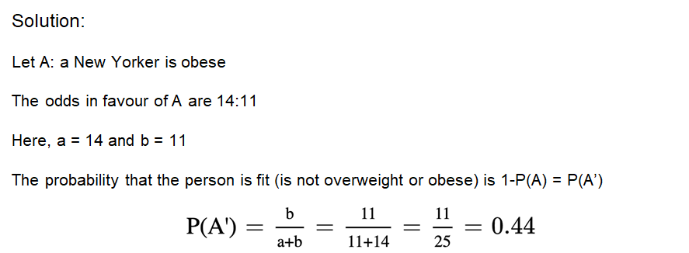
Odds - Solution

Slide 27
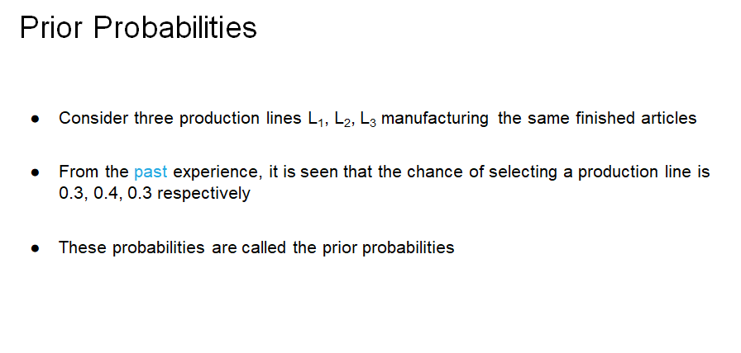

Slide 28
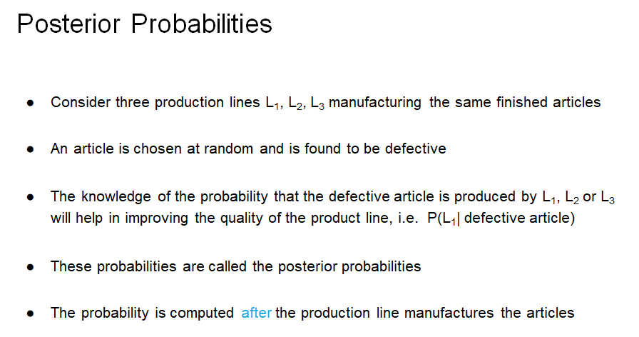

Slide 29
Bayes Theorem
Bayes’ Theorem is used to revise previously calculated probabilities based on new information.
Developed by Thomas Bayes in the 18th Century.
It is an extension of conditional probability.

Slide 30
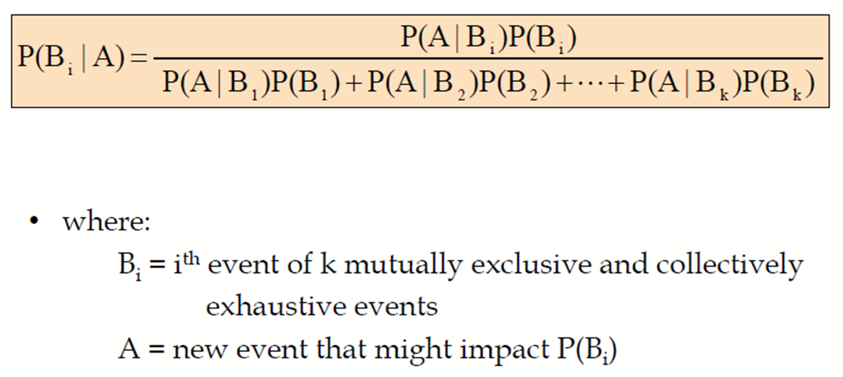
Bayes Theorem
Given a hypothesis H and evidence E, Bayes theorem states that the relationship between the probability of hypothesis P(H) before getting the evidence and the probability of P(H/E) of the hypothesis after getting the evidence is P(H/E) = P(E/H)*P(H)/P(E)

Slide 31
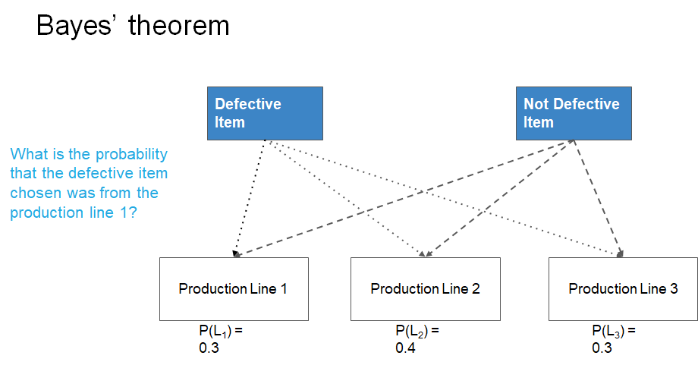

Slide 32
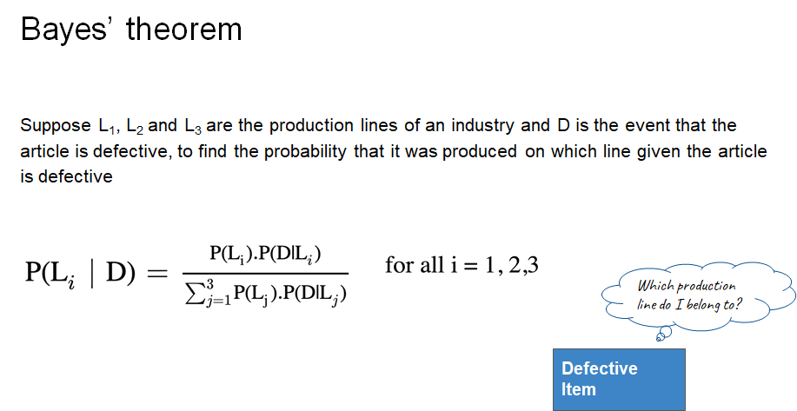

Slide 34
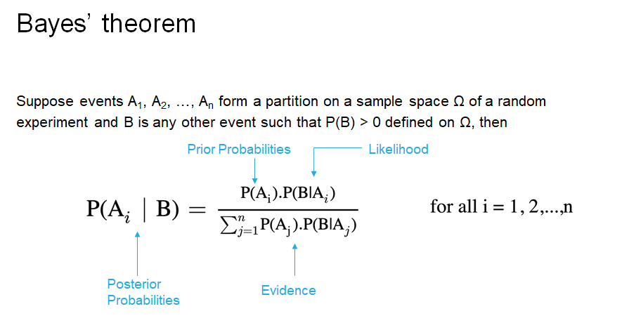

Slide 35
Bayes Theorem
Bayesian spam filtering example :
Event A = The message is spam.
p(spam) = 0.8
Event B = Message contains money as a word in it.
p(word/spam) = 0.7
p(word) = 0.6
P(spam/word) = p(word/spam) * p(spam)
p(word)
P(spam/word) = 0.7*0.8 / 0.6
= 0.933

Slide 36
Bayes Theorem - Application
Naive Bayes algorithm
Spam filtering use case
Interpretation of statistical results

Slide 37
Example :
An insurance company divides its clients into two categories: those who are accident prone and who are not. Statistics show there is a 40% chance an accident prone person will have an accident within 1 year whereas a 20% chance non-accident prone people will have an accident within the first year.
If 30% of the population is accident prone, what is the probability that a new policyholder has an accident within 1 year?

Slide 39
Let A be the event a person is accident prone
Let A^{c} be the event a person is not accident prone
Let F be the event a person has an accident within 1 year
An event a person is not accident prone (A^{c})
A^{c}
0.70
40%
20%
A person has an accident within one year (F)
0.30
A
An event a person is accident prone

Slide 40



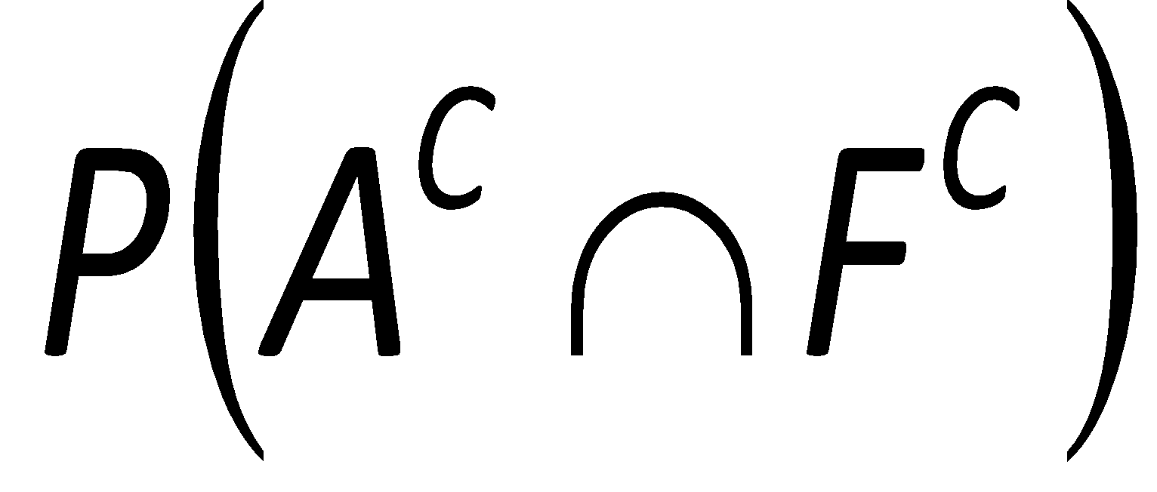
Probability Tree
Accident w/in 1 year P(F|A)=0.40
Accident Prone P(A) = 0.30
No Accident w/in 1 year P(F^{C}|A)=0.60
Accident w/in 1 year P(F|A^{C})=0.20
Not Accident Prone P(A^{C}) = 0.70
No Accident w/in 1 year P(F^{C}|A^{C})=0.80

